Slide 1

ANNUAL PERFORMANCE REVIEW
From Raw Data to Revenue Story
FY 2024 E-Commerce Analytics: Forecasting, SQL Insights, and Actionable Growth Strategies.

Slide 2

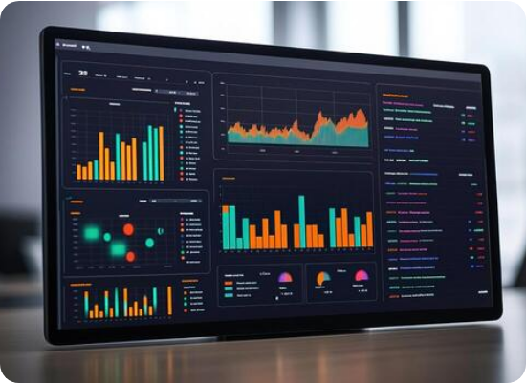
Executive Summary: The Big Picture
FY 2024 Highlights
We achieved $4.2M in Total Revenue, marking a significant 18.3% YoY growth. This performance was driven by quality-led expansion in premium segments.
APAC region emerged as the primary growth engine.
AOV increased by 6.0%, reaching a global average of $109.
Onboarding redesign successfully boosted M1 retention.

Slide 3
Performance Deep Dive
Analyzing regional growth, KPI variance, and customer value distribution.

Slide 4






FY 2024 Global KPI Dashboard
$4.2M
38,490
$109
12.4%
Total Revenue
Total Orders
Avg Order Value
Churn Rate
↑ 18.3% YoY
↑ 11.6% YoY
↑ 6.0% YoY
↑ 1.1pp YoY
Regional churn tracking is required to mitigate the 1.1pp increase observed in Q4.

Slide 5
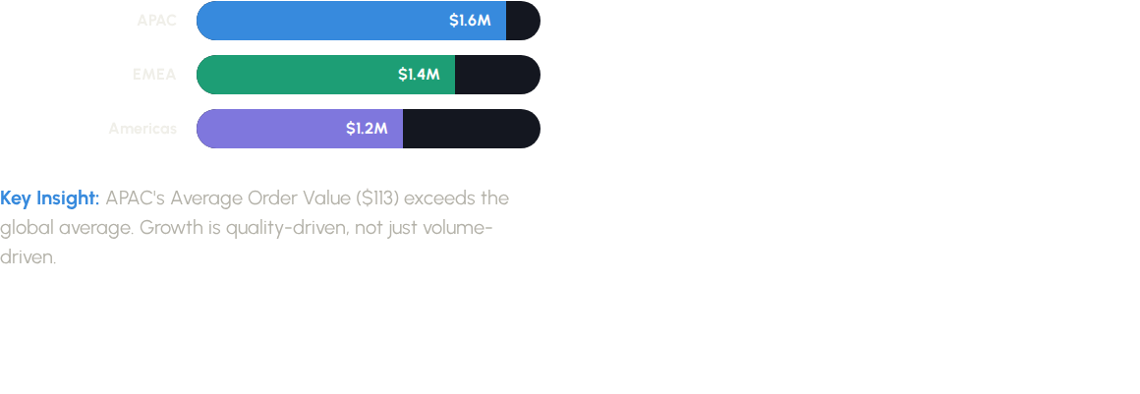

APAC Dominance in Global Growth

Slide 6
Operational Efficiency
Optimization of the conversion funnel and customer lifecycle retention.

Slide 7
Closing the $380K Checkout Gap
Funnel Performance
34%
With 520K sessions translating to 38K purchases, the primary leak occurs at the checkout stage.
Sessions: 520,000 (100%)
Add to Cart: 96,000 (18%)
Purchase: 38,490 (7.4%)
Drop at Checkout
Recovering just 8% of abandoned carts adds $380K to ARR.

Slide 8
Cohort Retention Matrix
Cohort | M0 | M1 | M2 | M3 | M4
Jan 24 | 100% | 68% | 54% | 48% | 42%
Mar 24 | 100% | 69% | 55% | 49% | -
Jun 24 | 100% | 74% | - | - | -
Strategy Success: M1 retention improved from 68% to 74% following the June onboarding redesign. Target is 75% for Q1 2025.

Slide 9
Strategic Outlook
Revenue forecasting and customer segmentation strategies for FY 2025.

Slide 10
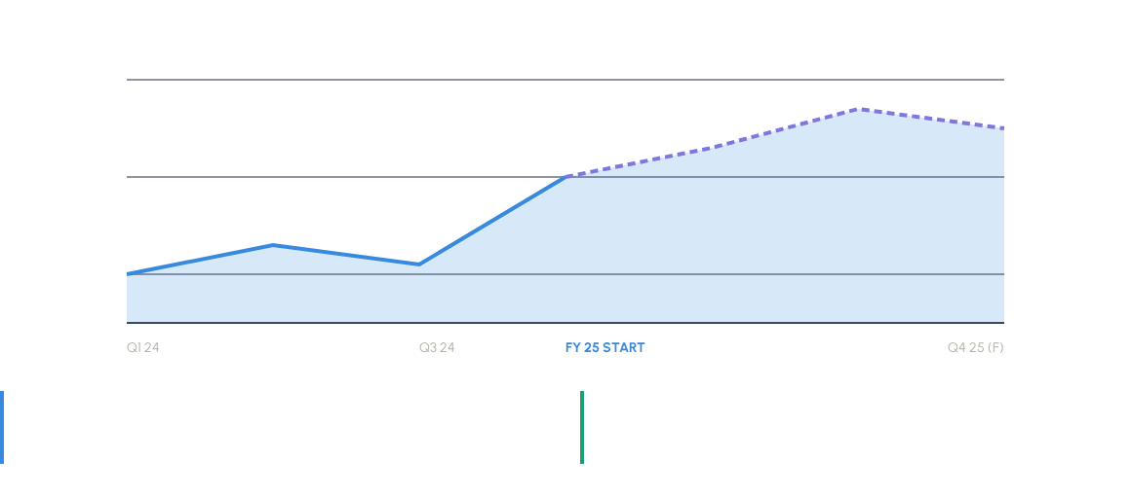
FY 2025 Revenue Projections
Base Scenario: +2% MoM growth leads to $5.1M ARR in 2025.
Bull Case: Premium expansion in APAC could push revenue to $5.9M.

Slide 11

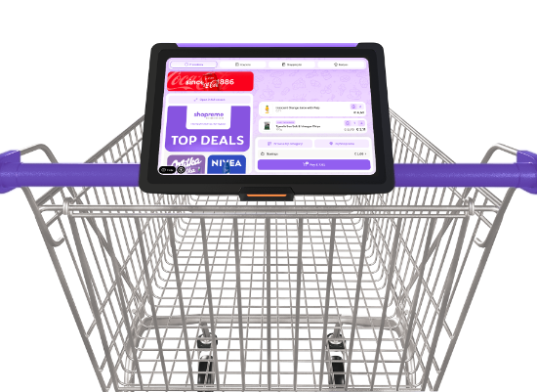
RFM Segmentation Strategy
Champions
Loyal
6,928 Customers
11,540 Customers
Action: Reward with VIP early access.
Action: Upsell high-frequency items.
New Biz
At Risk
8,260 Customers
2,412 Customers
Action: Trigger welcome drip series.
Action: Automated win-back campaign.

Slide 12


Q&A
Next Steps for Q1 2025:
Scale APAC Premium SKUs
A/B Test Checkout UX Optimization
Deploy RFM Win-back Campaigns

Slide 13




Image Sources
https://static.vecteezy.com/system/resources/thumbnails/052/958/468/small/modern-data-analytics-dashboard-display-free-photo.jpg
Source: www.vecteezy.com
https://static.vecteezy.com/system/resources/previews/077/134/759/non_2x/abstract-data-visualization-blue-tones-image-vector.jpg
Source: www.vecteezy.com
https://framerusercontent.com/images/FIXVBt1uzlwI4pavUKL76IEV0Ek.png?width=2000&height=1326
Source: shopreme.com
https://d3njjcbhbojbot.cloudfront.net/api/utilities/v1/imageproxy/https://images.ctfassets.net/wp1lcwdav1p1/7lNAyDcDf0sGWETXGwiGW2/6e528f7c5b69402a9932f477ce01fd60/GettyImages-1335397037-converted-from-jpg.webp?w=1500&h=680&q=60&fit=fill&f=faces&fm=jpg&fl=progressive&auto=format%2Ccompress&dpr=1&w=1000
Source: www.coursera.org

